Slide 1
Problem statement: Use an RNN to predict the sentiment of the following document
I love cats → 1 (positive)

Slide 2
(S) Sequence Length = 4
(E) Embedding Size = 3
(H) Hidden State Dimensions = 2
(Y) Output Dimension = 1
Epoch 1
1
Compute Hidden State Contribution From Input
3 | 1
-1 | -2
0 | 1
X
=
0 | 2 | 3
-2 | -1
Proposed Hidden State From Input
1 x 2
Input Token “I”
1 x 3
(1 token x E)
EH Weights
3 x 2
(E x H)
Sequence Step 1/4

Slide 3
(S) Sequence Length = 4
(E) Embedding Size = 3
(H) Hidden State Dimensions = 2
(Y) Output Dimension = 1
Epoch 1
Compute Hidden State Contribution From Previous Hidden State
1 | 2
X
3 | 1
-1 | -2
=
2
1 | 2
Previous Hidden State
1 x 2
Proposed Hidden State From Prev Hidden State
1 x 2
HH Weights
2 x 2
(H x H)
1
Compute Hidden State Contribution From Input
3 | 1
-1 | -2
0 | 1
X
=
0 | 2 | 3
-2 | -1
Proposed Hidden State From Input
1 x 2
Input Token “I”
1 x 3
(1 token x E)
EH Weights
3 x 2
(E x H)
Sequence Step 1/4

Slide 4
(S) Sequence Length = 4
(E) Embedding Size = 3
(H) Hidden State Dimensions = 2
(Y) Output Dimension = 1
Epoch 1
Compute Hidden State Contribution From Previous Hidden State
1 | 2
X
3 | 1
-1 | -2
=
2
1 | 2
Previous Hidden State
1 x 2
Proposed Hidden State From Prev Hidden State
1 x 2
HH Weights
2 x 2
(H x H)
1
Compute Hidden State Contribution From Input
3 | 1
-1 | -2
0 | 1
X
=
3
Update Hidden State
0 | 2 | 3
-2 | -1
tanh(
)
Proposed Hidden State From Input
1 x 2
+
=
-2 | -1
1 | 2
-0.76 | 0.76
Input Token “I”
1 x 3
(1 token x E)
EH Weights
3 x 2
(E x H)
Proposed Hidden State From Input
Proposed Hidden State From Prev Hidden State
~
-1 | 1
New Hidden State
1 x 2
Sequence Step 1/4

Slide 5
(S) Sequence Length = 4
(E) Embedding Size = 3
(H) Hidden State Dimensions = 2
(Y) Output Dimension = 1
Epoch 1
Compute Hidden State Contribution From Previous Hidden State
1 | 1
X
3 | 1
-1 | -2
=
2
1 | 2
Previous Hidden State
1 x 2
Proposed Hidden State From Prev Hidden State
1 x 2
HH Weights
2 x 2
(H x H)
1
Compute Hidden State Contribution From Input
3 | 1
-1 | -2
0 | 1
X
=
3
Update Hidden State
0 | 2 | 3
-2 | -1
tanh(
)
Proposed Hidden State From Input
1 x 2
+
=
-2 | -1
1 | 2
-0.76 | 0.76
Input Token “I”
1 x 3
(1 token x E)
EH Weights
3 x 2
(E x H)
Proposed Hidden State From Input
Proposed Hidden State From Prev Hidden State
~
-1 | 1
New Hidden State
1 x 2
4
Compute Output
X
2 | -2
=
-1 | 1
-4
New Hidden State
1 x 2
HY Weights
2 x 1
(H x Y)
Sequence Step 1/4

Slide 6
(S) Sequence Length = 4
(E) Embedding Size = 3
(H) Hidden State Dimensions = 2
(Y) Output Dimension = 1
Epoch 1
Compute Hidden State Contribution From Previous Hidden State
1 | 2
X
3 | 1
-1 | -2
=
2
1 | 2
Previous Hidden State
1 x 2
Proposed Hidden State From Prev Hidden State
1 x 2
HH Weights
2 x 2
(H x H)
1
Compute Hidden State Contribution From Input
3 | 1
-1 | -2
0 | 1
X
=
3
Update Hidden State
0 | 2 | 3
-2 | -1
tanh(
)
Proposed Hidden State From Input
1 x 2
+
=
-2 | -1
1 | 2
-0.76 | 0.76
Input Token “I”
1 x 3
(1 token x E)
EH Weights
3 x 2
(E x H)
Proposed Hidden State From Input
Proposed Hidden State From Prev Hidden State
~
-1 | 1
5
New Hidden State
1 x 2
Compute Output
4
Compute Output
X
2 | -2
=
sigmoid(
)
=
-1 | 1
-4
-4
0.18
New Hidden State
1 x 2
HY Weights
2 x 1
(H x Y)
Our predicted sentiment at sequence step 1
Sequence Step 1/4

Slide 7
(S) Sequence Length = 4
(E) Embedding Size = 3
(H) Hidden State Dimensions = 2
(Y) Output Dimension = 1
Epoch 1
1
Compute Hidden State Contribution From Input
3 | 1
-1 | -2
0 | 1
X
=
2 | -1 | 2
7 | 6
Proposed Hidden State From Input
1 x 2
Input Token “Love”
1 x 3
(1 token x E)
EH Weights
3 x 2
(E x H)
Sequence Step 2/4

Slide 8
(S) Sequence Length = 4
(E) Embedding Size = 3
(H) Hidden State Dimensions = 2
(Y) Output Dimension = 1
Epoch 1
Compute Hidden State Contribution From Previous Hidden State
-1 | 1
X
3 | 1
-1 | -2
=
2
-4 | -3
Previous Hidden State
1 x 2
Proposed Hidden State From Prev Hidden State
1 x 2
HH Weights
2 x 2
(H x H)
1
Compute Hidden State Contribution From Input
3 | 1
-1 | -2
0 | 1
X
=
2 | -1 | 2
7 | 6
Proposed Hidden State From Input
1 x 2
Input Token “Love”
1 x 3
(1 token x E)
EH Weights
3 x 2
(E x H)
Sequence Step 2/4

Slide 9
(S) Sequence Length = 4
(E) Embedding Size = 3
(H) Hidden State Dimensions = 2
(Y) Output Dimension = 1
Epoch 1
Compute Hidden State Contribution From Previous Hidden State
-1 | 1
X
3 | 1
-1 | -2
=
2
-4 | -3
Previous Hidden State
1 x 2
Proposed Hidden State From Prev Hidden State
1 x 2
HH Weights
2 x 2
(H x H)
1
Compute Hidden State Contribution From Input
3 | 1
-1 | -2
0 | 1
X
=
3
Update Hidden State
2 | -1 | 2
7 | 6
tanh(
)
Proposed Hidden State From Input
1 x 2
+
=
7 | 6
-4 | -3
.99 | .99
Input Token “Love”
1 x 3
(1 token x E)
EH Weights
3 x 2
(E x H)
Proposed Hidden State From Input
Proposed Hidden State From Prev Hidden State
~
1 | 1
New Hidden State
1 x 2
Sequence Step 2/4

Slide 10
(S) Sequence Length = 4
(E) Embedding Size = 3
(H) Hidden State Dimensions = 2
(Y) Output Dimension = 1
Epoch 1
Compute Hidden State Contribution From Previous Hidden State
-1 | 1
X
3 | 1
-1 | -2
=
2
-4 | -3
Previous Hidden State
1 x 2
Proposed Hidden State From Prev Hidden State
1 x 2
HH Weights
2 x 2
(H x H)
1
Compute Hidden State Contribution From Input
3 | 1
-1 | -2
0 | 1
X
=
3
Update Hidden State
2 | -1 | 2
7 | 6
tanh(
)
Proposed Hidden State From Input
1 x 2
+
=
7 | 6
-4 | -3
.99 | .99
Input Token “Love”
1 x 3
(1 token x E)
EH Weights
3 x 2
(E x H)
Proposed Hidden State From Input
Proposed Hidden State From Prev Hidden State
~
1 | 1
New Hidden State
1 x 2
4
Compute Output
X
2 | -2
=
1 | 1
0
New Hidden State
1 x 2
HY Weights
2 x 1
(H x Y)
Sequence Step 2/4

Slide 11
(S) Sequence Length = 4
(E) Embedding Size = 3
(H) Hidden State Dimensions = 2
(Y) Output Dimension = 1
Epoch 1
Compute Hidden State Contribution From Previous Hidden State
-1 | 1
X
3 | 1
-1 | -2
=
2
-4 | -3
Previous Hidden State
1 x 2
Proposed Hidden State From Prev Hidden State
1 x 2
HH Weights
2 x 2
(H x H)
1
Compute Hidden State Contribution From Input
3 | 1
-1 | -2
0 | 1
X
=
3
Update Hidden State
2 | -1 | 2
7 | 6
tanh(
)
Proposed Hidden State From Input
1 x 2
+
=
7 | 6
-4 | -3
.99 | .99
Input Token “Love”
1 x 3
(1 token x E)
EH Weights
3 x 2
(E x H)
Proposed Hidden State From Input
Proposed Hidden State From Prev Hidden State
~
1 | 1
5
New Hidden State
1 x 2
Compute Output
4
Compute Output
X
2 | -2
=
sigmoid(
)
=
1 | 1
0
0
0.5
New Hidden State
1 x 2
HY Weights
2 x 1
(H x Y)
Our predicted sentiment at sequence step 2
Sequence Step 2/4

Slide 12
(S) Sequence Length = 4
(E) Embedding Size = 3
(H) Hidden State Dimensions = 2
(Y) Output Dimension = 1
Epoch 1
1
Compute Hidden State Contribution From Input
3 | 1
-1 | -2
0 | 1
X
=
-1 | -1 | -2
-2 | 3
Proposed Hidden State From Input
1 x 2
Input Token “Cats”
1 x 3
(1 token x E)
EH Weights
3 x 2
(E x H)
Sequence Step 3/4

Slide 13
(S) Sequence Length = 4
(E) Embedding Size = 3
(H) Hidden State Dimensions = 2
(Y) Output Dimension = 1
Epoch 1
Compute Hidden State Contribution From Previous Hidden State
1 | 1
X
3 | 1
-1 | -2
=
2
2 | -1
Previous Hidden State
1 x 2
Proposed Hidden State From Prev Hidden State
1 x 2
HH Weights
2 x 2
(H x H)
1
Compute Hidden State Contribution From Input
3 | 1
-1 | -2
0 | 1
X
=
-1 | -1 | -2
-2 | 3
Proposed Hidden State From Input
1 x 2
Input Token “Cats”
1 x 3
(1 token x E)
EH Weights
3 x 2
(E x H)
Sequence Step 3/4

Slide 14
(S) Sequence Length = 4
(E) Embedding Size = 3
(H) Hidden State Dimensions = 2
(Y) Output Dimension = 1
Epoch 1
Compute Hidden State Contribution From Previous Hidden State
1 | 1
X
3 | 1
-1 | -2
=
2
2 | -1
Previous Hidden State
1 x 2
Proposed Hidden State From Prev Hidden State
1 x 2
HH Weights
2 x 2
(H x H)
1
Compute Hidden State Contribution From Input
3 | 1
-1 | -2
0 | 1
X
=
3
Update Hidden State
-1 | -1 | -2
-2 | 3
tanh(
)
Proposed Hidden State From Input
1 x 2
+
=
-2 | 3
2 | -1
0 | .96
Input Token “Cats”
1 x 3
(1 token x E)
EH Weights
3 x 2
(E x H)
Proposed Hidden State From Input
Proposed Hidden State From Prev Hidden State
~
0 | 1
New Hidden State
1 x 2
Sequence Step 3/4

Slide 15
(S) Sequence Length = 4
(E) Embedding Size = 3
(H) Hidden State Dimensions = 2
(Y) Output Dimension = 1
Epoch 1
Compute Hidden State Contribution From Previous Hidden State
1 | 1
X
3 | 1
-1 | -2
=
2
2 | -1
Previous Hidden State
1 x 2
Proposed Hidden State From Prev Hidden State
1 x 2
HH Weights
2 x 2
(H x H)
1
Compute Hidden State Contribution From Input
3 | 1
-1 | -2
0 | 1
X
=
3
Update Hidden State
-1 | -1 | -2
-2 | 3
tanh(
)
Proposed Hidden State From Input
1 x 2
+
=
-2 | 3
2 | -1
0 | .96
Input Token “Cats”
1 x 3
(1 token x E)
EH Weights
3 x 2
(E x H)
Proposed Hidden State From Input
Proposed Hidden State From Prev Hidden State
~
0 | 1
New Hidden State
1 x 2
4
Compute Output
X
2 | -2
=
0 | 1
-2
New Hidden State
1 x 2
HY Weights
2 x 1
(H x Y)
Sequence Step 3/4

Slide 16
(S) Sequence Length = 4
(E) Embedding Size = 3
(H) Hidden State Dimensions = 2
(Y) Output Dimension = 1
Epoch 1
Compute Hidden State Contribution From Previous Hidden State
1 | 1
X
3 | 1
-1 | -2
=
2
2 | -1
Previous Hidden State
1 x 2
Proposed Hidden State From Prev Hidden State
1 x 2
HH Weights
2 x 2
(H x H)
1
Compute Hidden State Contribution From Input
3 | 1
-1 | -2
0 | 1
X
=
3
Update Hidden State
-1 | -1 | -2
-2 | 3
tanh(
)
Proposed Hidden State From Input
1 x 2
+
=
-2 | 3
2 | -1
0 | .96
Input Token “Cats”
1 x 3
(1 token x E)
EH Weights
3 x 2
(E x H)
Proposed Hidden State From Input
Proposed Hidden State From Prev Hidden State
~
0 | 1
5
New Hidden State
1 x 2
Compute Output
4
Compute Output
X
2 | -2
=
sigmoid(
)
=
0 | 1
-2
-2
0.12
New Hidden State
1 x 2
HY Weights
2 x 1
(H x Y)
Our predicted sentiment at sequence step 3
Sequence Step 3/4

Slide 17
(S) Sequence Length = 4
(E) Embedding Size = 3
(H) Hidden State Dimensions = 2
(Y) Output Dimension = 1
Epoch 1
1
Compute Hidden State Contribution From Input
3 | 1
-1 | -2
0 | 1
X
=
0 | 0 | 0
0 | 0
Input Token “EMPTY_TOKEN”
1 x 3
(1 token x E)
Proposed Hidden State From Input
1 x 2
EH Weights
3 x 2
(E x H)
Sequence Step 4/4

Slide 18
Epoch 1
(S) Sequence Length = 4
(E) Embedding Size = 3
(H) Hidden State Dimensions = 2
(Y) Output Dimension = 1
Compute Hidden State Contribution From Previous Hidden State
0 | 1
X
3 | 1
-1 | -2
=
2
-1 | -2
Previous Hidden State
1 x 2
Proposed Hidden State From Prev Hidden State
1 x 2
HH Weights
2 x 2
(H x H)
1
Compute Hidden State Contribution From Input
3 | 1
-1 | -2
0 | 1
X
=
0 | 0 | 0
0 | 0
Input Token “EMPTY_TOKEN”
1 x 3
(1 token x E)
Proposed Hidden State From Input
1 x 2
EH Weights
3 x 2
(E x H)
Sequence Step 4/4

Slide 19
(S) Sequence Length = 4
(E) Embedding Size = 3
(H) Hidden State Dimensions = 2
(Y) Output Dimension = 1
Epoch 1
Compute Hidden State Contribution From Previous Hidden State
0 | 1
X
3 | 1
-1 | -2
=
2
-1 | -2
Previous Hidden State
1 x 2
Proposed Hidden State From Prev Hidden State
1 x 2
HH Weights
2 x 2
(H x H)
1
Compute Hidden State Contribution From Input
3 | 1
-1 | -2
0 | 1
X
=
3
Update Hidden State
0 | 0 | 0
0 | 0
tanh(
)
Proposed Hidden State From Input
1 x 2
+
=
Input Token “EMPTY_TOKEN”
1 x 3
(1 token x E)
0 | 0
-1 | -2
-.76 | -.96
EH Weights
3 x 2
(E x H)
Proposed Hidden State From Input
Proposed Hidden State From Prev Hidden State
~
-1 | -1
New Hidden State
1 x 2
Sequence Step 4/4

Slide 20
(S) Sequence Length = 4
(E) Embedding Size = 3
(H) Hidden State Dimensions = 2
(Y) Output Dimension = 1
Epoch 1
Compute Hidden State Contribution From Previous Hidden State
0 | 1
X
3 | 1
-1 | -2
=
2
-1 | -2
Previous Hidden State
1 x 2
Proposed Hidden State From Prev Hidden State
1 x 2
HH Weights
2 x 2
(H x H)
1
Compute Hidden State Contribution From Input
3 | 1
-1 | -2
0 | 1
X
=
3
Update Hidden State
0 | 0 | 0
0 | 0
tanh(
)
Proposed Hidden State From Input
1 x 2
+
=
Input Token “EMPTY_TOKEN”
1 x 3
(1 token x E)
0 | 0
-1 | -2
-.76 | -.96
EH Weights
3 x 2
(E x H)
Proposed Hidden State From Input
Proposed Hidden State From Prev Hidden State
~
-1 | -1
New Hidden State
1 x 2
4
Compute Output
X
2 | -2
=
-1 | -1
0
New Hidden State
1 x 2
HY Weights
2 x 1
(H x Y)
Sequence Step 4/4

Slide 21
(S) Sequence Length = 4
(E) Embedding Size = 3
(H) Hidden State Dimensions = 2
(Y) Output Dimension = 1
Epoch 1
Compute Hidden State Contribution From Previous Hidden State
0 | 1
X
3 | 1
-1 | -2
=
2
-1 | -2
Previous Hidden State
1 x 2
Proposed Hidden State From Prev Hidden State
1 x 2
HH Weights
2 x 2
(H x H)
1
Compute Hidden State Contribution From Input
3 | 1
-1 | -2
0 | 1
X
=
3
Update Hidden State
0 | 0 | 0
0 | 0
tanh(
)
Proposed Hidden State From Input
1 x 2
+
=
Input Token “EMPTY_TOKEN”
1 x 3
(1 token x E)
0 | 0
-1 | -2
-.76 | -.96
EH Weights
3 x 2
(E x H)
Proposed Hidden State From Input
Proposed Hidden State From Prev Hidden State
~
-1 | -1
5
New Hidden State
1 x 2
Compute Output
4
Compute Output
X
2 | -2
=
sigmoid(
)
=
-1 | -1
0
0
0.5
New Hidden State
1 x 2
HY Weights
2 x 1
(H x Y)
Our predicted sentiment at sequence step 4
Sequence Step 4/4

Slide 22

Epoch 1
predicted y = 0.5
true y = 1
Binary Cross-Entropy (Log Loss) Function
Loss is -log(0.5) → 0.3

Slide 23
Epoch 1
predicted y = 0.5
true y = 1
Binary Cross-Entropy (Log Loss) Function
Loss is -log(0.5) → 0.3
If this was the only sample in our training dataset, we would be done with 1 epoch. We then use our log loss function to calculate the partial derivatives needed to update our weights
3 | 1
-1 | -2
0 | 1
3 | 1
-1 | -2
2 | -2
HY Weights
2 x 1
(H x Y)
HH Weights
2 x 2
(H x H)
EH Weights
3 x 2
(E x H)

Slide 24
Epoch 2
predicted y = 0.78
true y = 1
Binary Cross-Entropy (Log Loss) Function
Loss is -log(0.78) → 0.108
Pretend we update our weights via backpropagation, and make a new prediction for “I love cats” of 0.78.
2 | 2
1 | -1
-2 | 2
-1 | 2
-0 | 2
1 | -3
HY Weights
2 x 1
(H x Y)
HH Weights
2 x 2
(H x H)
EH Weights
3 x 2
(E x H)

Slide 25
Epoch 3
predicted y = 0.98
true y = 1
Binary Cross-Entropy (Log Loss) Function
Loss is -log(0.98) → 0.008
Pretend we update our weights via backpropagation, and make a new prediction for “I love cats” of 0.98.
3 | 2
2 | -1
-2 | 2
-2 | 2
-0 | 2
1 | -4
HY Weights
2 x 1
(H x Y)
HH Weights
2 x 2
(H x H)
EH Weights
3 x 2
(E x H)

Slide 26
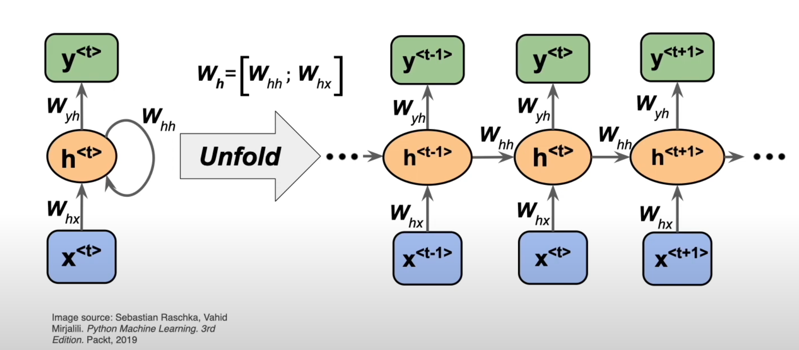
Backpropagation Through Time

Slide 27
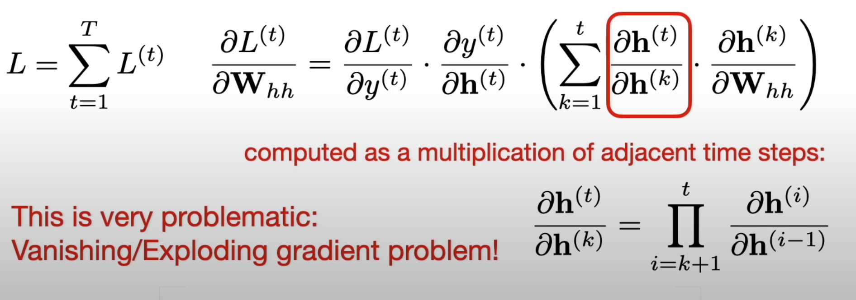
Backpropagation Through Time
Sebastian, Raschka, Backpropagation Through Time Overview

Slide 28
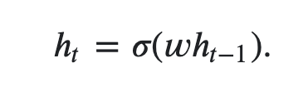
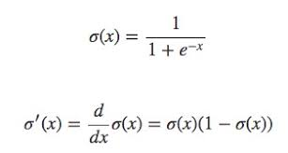
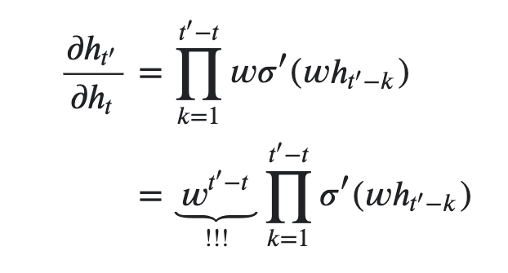
Backpropagation Through Time
Hidden state at sequence step t
Definition of the sigmoid activation function
Derivative of the sigmoid activation function
Derivative of the hidden state
https://stats.stackexchange.com/questions/140537/why-do-rnns-have-a-tendency-to-suffer-from-vanishing-exploding-gradient

